Slide 1
Unit Testing
Bradley Beecham
2018-04
Notes:
I’d like to make this a bit interactive…
Who knows what unit tests are?
Who doesn’t know what unit tests are?
Does that mean the rest of you don’t understand the question?
Who writes them as part of their daily coding?

Slide 2
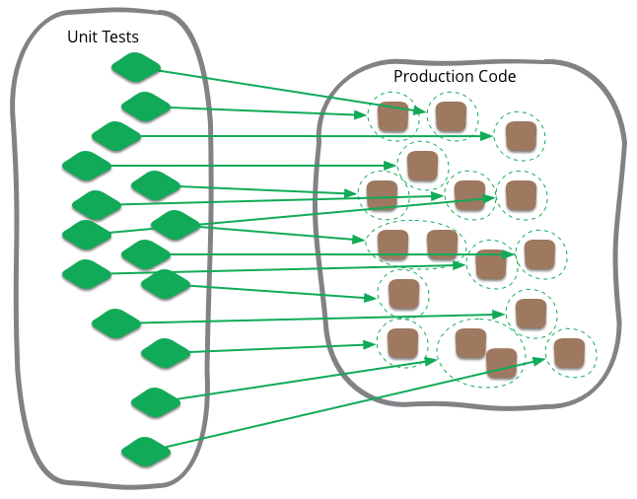

Safety Nets
Notes:
Code that test units of the system
----------------------
Think of unit test as safety nets.
Lots of them cover the entire system.
Shows that the Units are doing their bits correctly, not that features are doing the right thing.

Slide 3
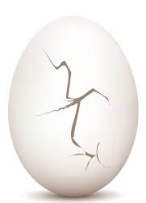
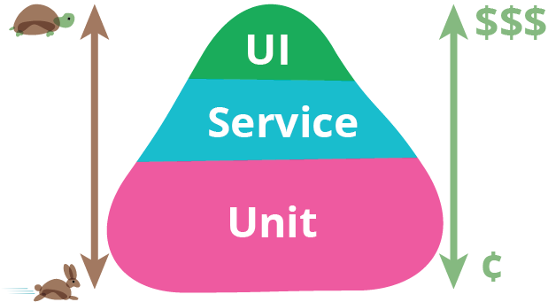
Testing Pyramid
Brittle – sensitive to change
More prone to intermittent failure
Notes:
Copied from Martin Flower.
Who can spot the extra graphic in this picture?
Would someone like to talk to it?

Slide 4
Characteristics of Unit Tests
Focus on small parts at a time - what is a unit?
Execute in milliseconds – what is an acceptable time for suite?
Run as regularly and as often as possible.
Written by programmers.
Integral part of CI / CD.
Notes:
What are some of the characteristics of Unit Tests

Slide 5
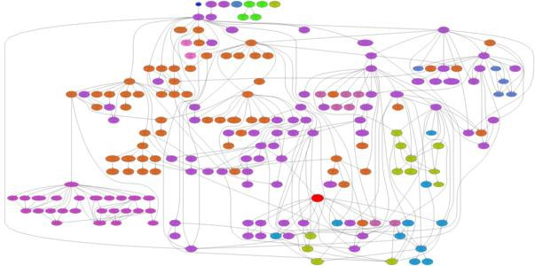
Ways of Being Useful
Instant feedback.
Speed of testing (n) cases.
Fosters good design.
Safety when refactoring.
Helpful to understand code.
Highlight cases you never thought of.
Tells you when you are done.
Quality
Notes:
Sets you up on path of success
------------------
Dependency diagram

Slide 6
Barriers to testing
No time - Talk your product owner and ask what the quality requirements are. Build testing time into your story pointing.
Convoluted codebase – probably because of short-term objectives at the expense of investing in longer-term code maintainability. Linked to #1
Google dem..
Notes:
What are some of the barriers to testing, maybe why you haven’t started yet?
-----------------
If you are NOT writing tests daily – google and see if you / your code / Genesis fit into one of the categories

Slide 7

How they make you feel
Notes:
We should all be writing Unit Tests.
Part of our responsibility to deliver Quality software.
On a scale of 1-10, are you ready to deploy to prod, now?

